Slide 1
Topic: Energy EQ: How is energy in food and exercise measured?
Mrs Parlevliet
Year 11 Essentials

Slide 2
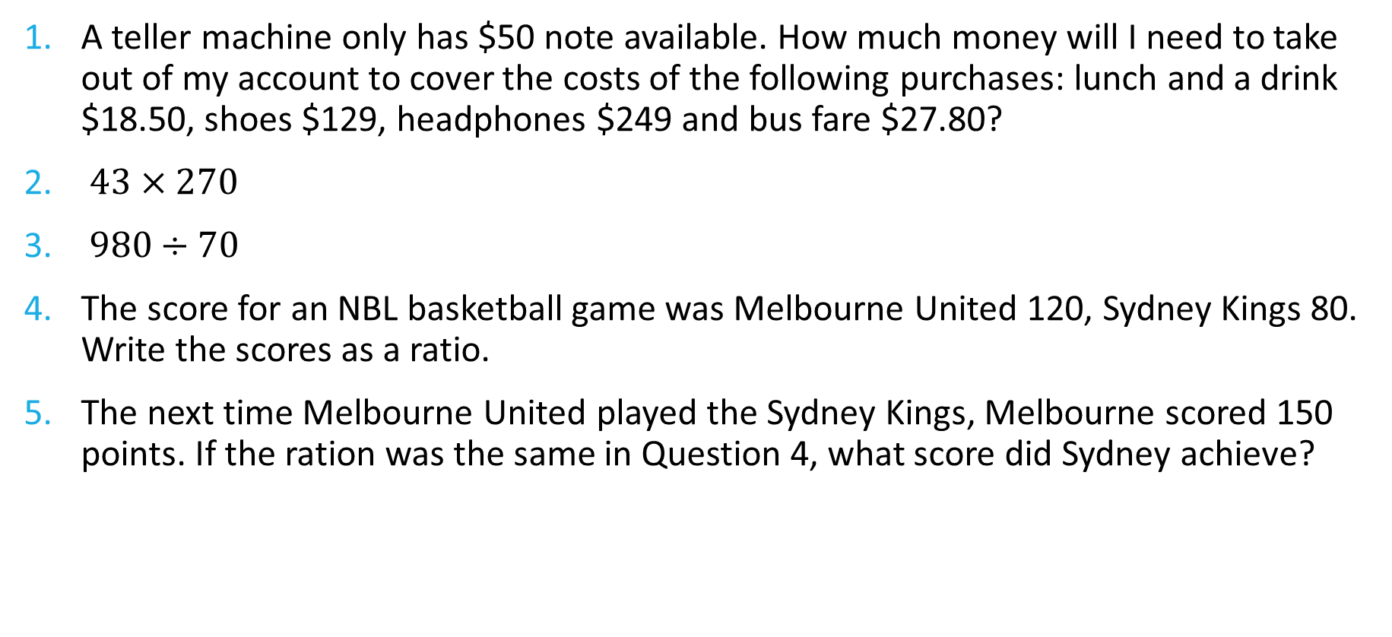
FiVe Questions
Topic: Energy
Date: XX/XX/2021
EQ – How is energy in food and exercise measured?
A teller machine only has $50 note available. How much money will I need to take out of my account to cover the costs of the following purchases: lunch and a drink $18.50, shoes $129, headphones $249 and bus fare $27.80?
$43×270$
$980÷70$
The score for an NBL basketball game was Melbourne United 120, Sydney Kings 80. Write the scores as a ratio.
The next time Melbourne United played the Sydney Kings, Melbourne scored 150 points. If the ration was the same in Question 4, what score did Sydney achieve?

Slide 3
24
7
30
Topic: Energy
Date: XX/XX/2021
EQ – How is energy in food and exercise measured?
What are kilojoules?
In Australia, the amount of energy in food and exercise is measured in kilojoules, (kJ). In some countries, this is still measured in calories, (cal), so many recipes and exercise activities so we need to understand both.
Conversion between calories and kilojoules
1 calorie ≈ 4.184 kilojoules
1 kilojoule = 1kJ = 1000 joules ≈ 239 calories
WICOR

Slide 4
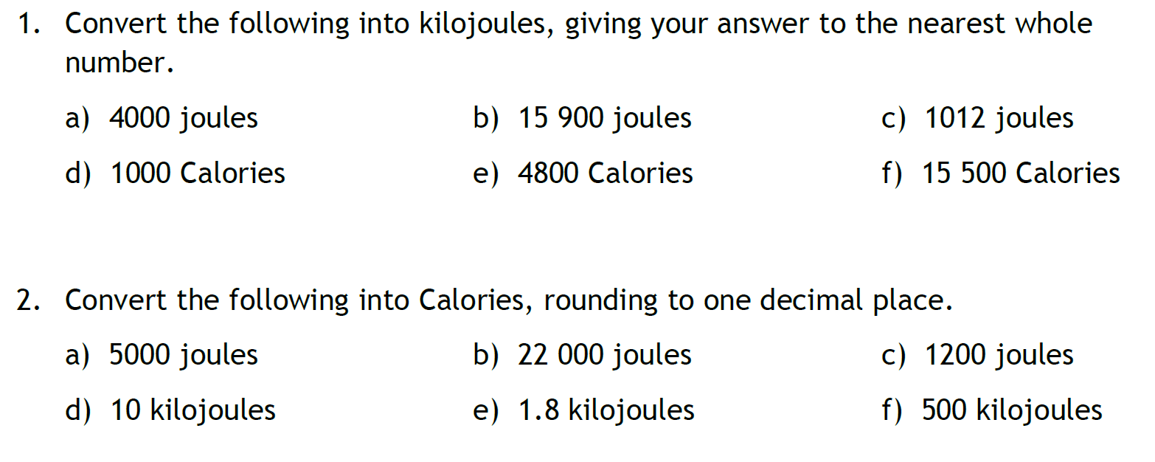
Guided Practice (LHS)
4 kJ
16 kJ
1 kJ
4184 kJ
20 083 kJ
64 582 kJ
1.2 cal
5.3 cal
0.3 cal
2.4 cal
0.4 cal
119.5 cal

Slide 5
24
7
30
Topic: Energy
Date: XX/XX/2021
EQ – How is energy in food and exercise measured?
What are daily requirements?
In Australia, there are recommended daily energy requirements that vary with age, size, and activity levels.
For example:
A female 18 year old student weighing 60kg would need 11413 kJ per day and by age 40 would only need 8925kJ.
A male 18 student old student weighing 60kg would need 12496 kJ per day and by age 40 would only need 10453 kJ.
WICOR

Slide 6
Task (LHS)
These are typical take away meals. Use the provided RDI figures to answer the following questions.
How many kilojoules are in each serving (if the meal does not feed one person)?
What percentage of the recommended daily intake, (RDI), this would make up?
Meal | Servings | Total kJ for meal | kJ/person | %RDI
Rogan Josh with naan bread | 2 | 6474 |  | Female 18 year old Male 18 year old
Fish and chips (battered) | 4 | 10132 |  | Female 18 year old Male 18 year old
Beef and black bean stir fry with fried rice | 2 | 4912 |  | Female 18 year old Male 18 year old
Sushi: 2 x Californian Rolls | 1 | 1280 |  | Female 18 year old Male 18 year old

Slide 7
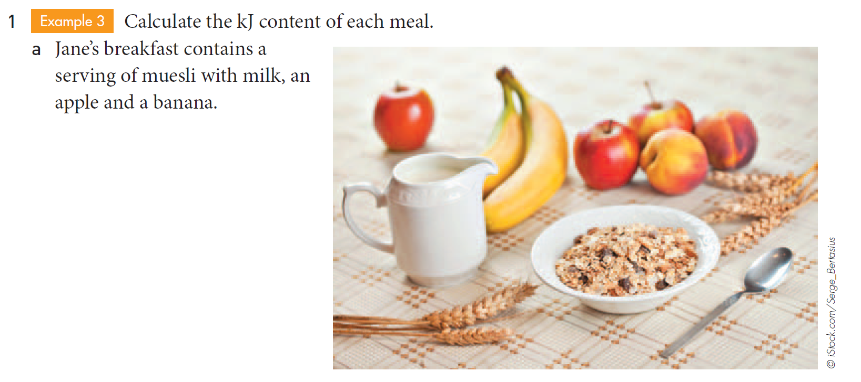
Task

Slide 8
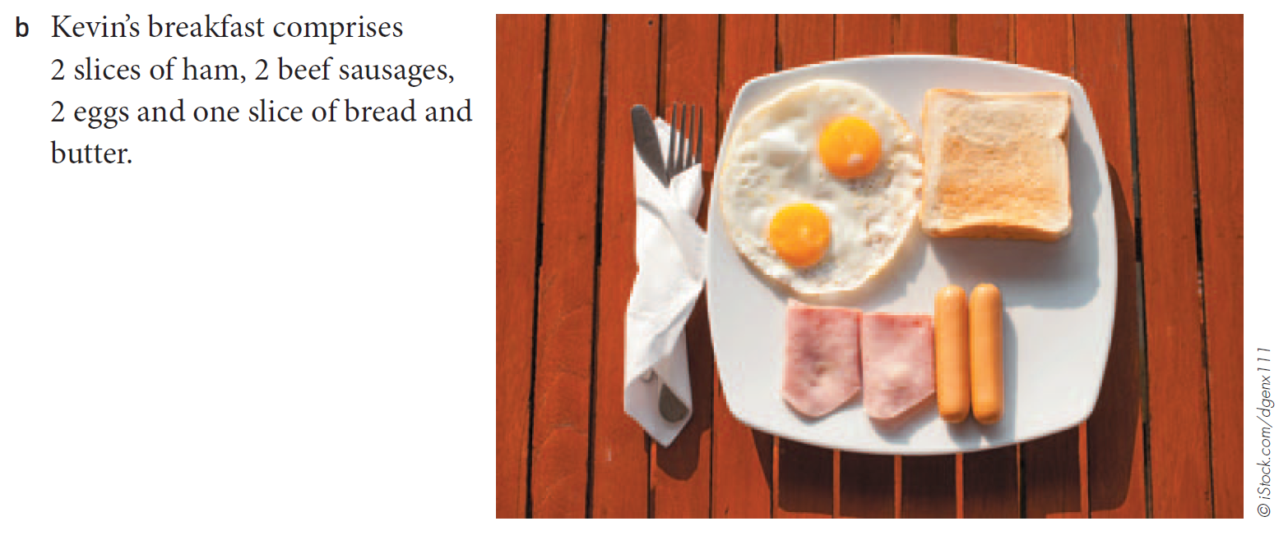
Task

Slide 9
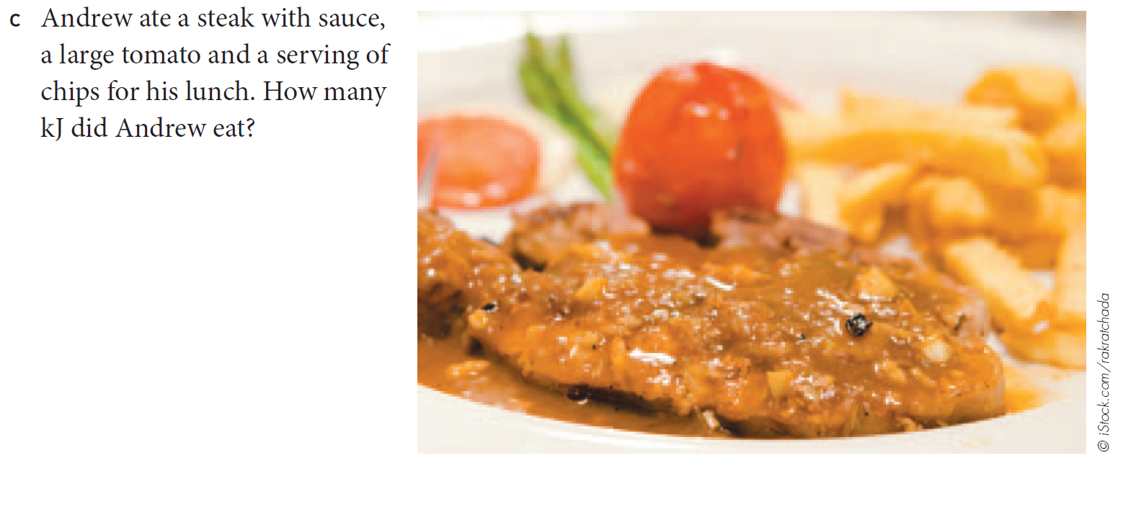
Task

Slide 10
24
7
30
Topic: Energy
Date: XX/XX/2021
EQ – How is energy in food and exercise measured?
How is exercise and energy related?
When we exercise, the rate of which energy is used will depend on the age, weight, and height of a person. If you are into fitness apps and wearable fitness devices you will know that they ask you to enter these details for tracking your progress.
WICOR

Slide 11
24
7
30
Topic: Energy
Date: XX/XX/2021
EQ – How is energy in food and exercise measured?
How is exercise and energy related?
Examples of the amount of energy burned in 5 minutes of different exercises for an 18 year old weighing 60kg and with a height of 165cm
Brisk walk: 80kJ for females, 70kJ for males
Gentle bike ride: 130 kJ for females, 110kJ males
Jogging: 170kJ for females, 150kJ for males
Soccer: 150kJ for females, 130 kJ for males
WICOR

Slide 12
Questions (LHS)
Order the activities from the most energy used to the least energy used
How much energy would be used in 30 minutes of each activity for females?
How much energy would be used in 30 minutes of each activity for males?
What would the energy be in calories instead of kilojoules?

Slide 13
Task, (p. 81 of text)
Find out how much energy is used in each of the following exercise options. Complete the table using an 18 year old student from the list above as an example. Add your thoughts about how achievable this is in a day and whether you like the form of exercise.
Exercise | kJ in 30 minutes | Convert to calories | What I think about the option
Brisk walking
Gentle bike ride
Jogging
Pilates
Dancing
Fishing
Gardening or Housework

Slide 14
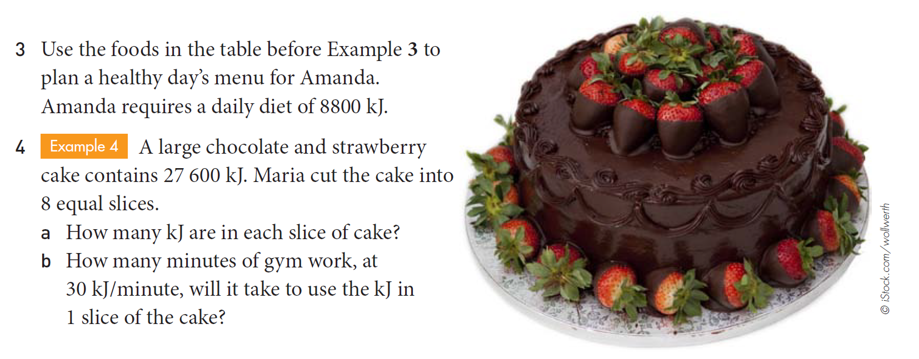
Task

Slide 15
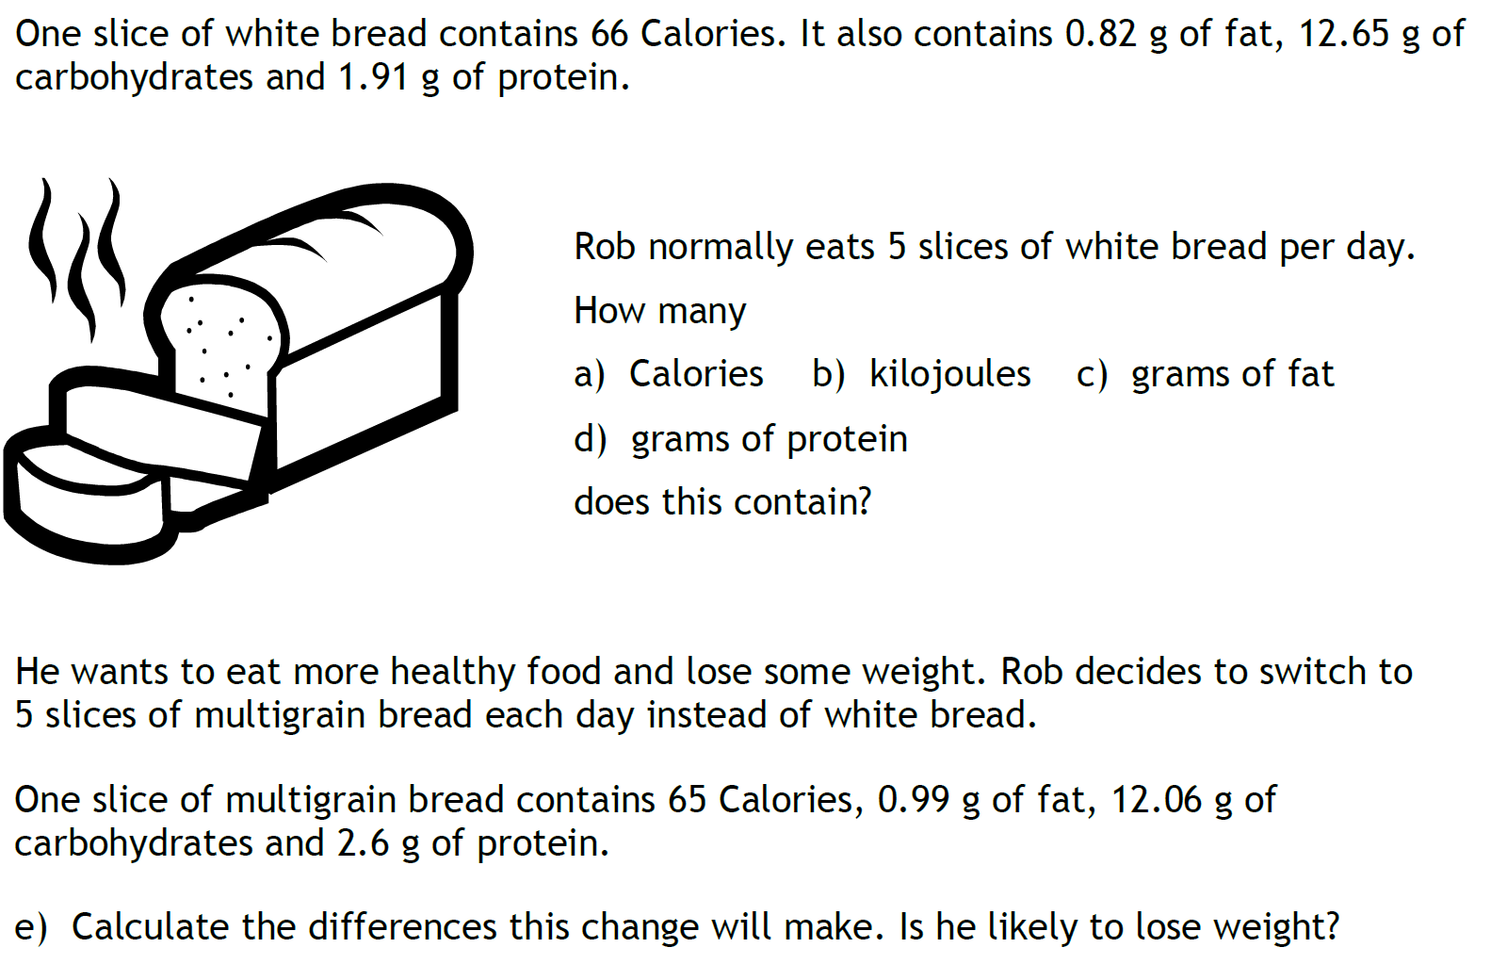
Task

